Slide 1
Requirements Management with Use Cases
Module 3
Analyzing the Problem

Slide 2
Course Outline
0 - About This Course
1 - Best Practices of Software Engineering
2 - Introduction to RMUC
3 - Analyzing the Problem
4 - Understanding Stakeholder Needs
5 - Defining the System
6 - Managing the Scope of the System
7 - Refining the System Definition
8 - Managing Changing Requirements
9 - Requirements Across the Product Lifecycle

Slide 3
Analyzing the Problem: Overview
Problem
Problem Space
Needs
Solution Space
Features
Traceability
The Product To Be Built
Software
Requirements
Test Procedures
Design
User Docs
Notes:
In this module, we discuss some ways to understand the problem we are addressing with the product that will be built.
Use this slide to explain where we are in the class:
In this module, we discuss some ways to understand the problem that we are addressing with the product that will be built.

Slide 4
Why Is Analyzing the Problem Important?
To avoid the “Yes, …, but ….”
  “Yes, {it meets the requirements},
  but {it doesn’t solve my problem}.”
Problem analysis time is on top of the pyramid
  It pays big dividends if you do it up front
Analysis work is transferable
  Problem Statement
    Subject is customer
      “I need to …”
  Requirement Statement
    Subject is system
      “The system provides …”
Notes:
What is the problem, really?
First, let us step back and analyze what problem our system will address.
There may be many different solutions that could fit our Problem Space. Our first step is to understand the problem and figure out the stakeholders’ needs in this area.
Why is this important?
For the first bullet point:
Ask “What is the first thing your customer says when you deliver the final software application?”
The students should answer some variation on “Yes,... But…”
Point out that there are different ways to fill in the blanks, and the students can each use their own words:
Another example:
“Yes, you did what I asked you to, but now that I see it, it is not what I want.”
Point out that the reason you get a “Yes,... But…” reaction at the end of the process is often because the developers (and also the customer) did not know what problem really needed to be solved.
For the second bullet point:
On your posted drawing of the pyramid, show how cutting a little work off the top cuts a lot of work off the rest of the pyramid.
For the third bullet point:
Illustrate with an example, such as:
In the problem statement, the subject is the customer
“I need to bank 24 hours a day.”
In the requirement statement, the subject is the system but the issue to be addressed is the same.
“The system provides banking 24 hours a day.”

Slide 5

Definition of a Problem
“A problem can be defined as the difference between
{Problem}
things as
perceived
things as
desired”
and
Gause & Weinberg, 1989
Notes:
If a difference does not exist between what you perceive you have, and what you desire to have, then there is not a problem. In our process, we first need to understand if there really is a problem.
This definition of a “problem” is different from many other ways to define the word “problem”. It addresses the gap between our perceptions of what our customer wants and what they actually desire. One advantage of this definition is that it emphasizes that there are many ways to solve a problem:
Change the customer’s perception of what they have now. For example, many of the requests for enhancements that Microsoft gets are for features that already exist.
Change the customer’s current desire. For example, if the customer finds that what they want will cost million of dollars over their budget, then maybe they will scale back their desires and focus on solving a simpler problem.
Change gap between what our customer wants and what they actually desire. A software solution is usually an attempt to narrow the gap.
This definition of “problem” comes from Gause and Weinberg. They have an excellent discussion of problem analysis.
See student notes about what to emphasize.

Slide 6
Steps in Problem Analysis
Step 1: Gain agreement on the problem being solved
Step 2: Identify stakeholders
Step 3: Define system boundaries
Step 4: Identify constraints imposed on the system
Notes:
Each of these steps is discussed in the following slides.
Write these steps on a easel!
Step 1 - Gain agreement on the problem being solved
Step 2 - Identify stakeholders
Step 3 - Define system boundaries
Step 4 - Identify constraint
Each of these steps will be discussed in the following slides, so don’t spend too much time on them here.
“How many people here studied Computer Science?”
“How many remember taking a course in compilers?”
“How many of you remember taking a course in figuring out what the problem is that you’re trying to solve?”
This isn’t usually taught in traditional education!
Explain that these steps are not done sequentially (as the numbering may imply). Instead, you will do the steps iteratively.
For example, during Step 1, you gain initial agreement on the problem to be solved. Then you go on to do Step 2, and identify some of the people affected by the outcome of the system to solve the problem. These people will have new ideas about the problem to be solved, so you will go back and do more work on Step 1.

Slide 7
Step 1. Gain Agreement
What is the problem?
  We technologists tend to rush headlong into solution providing - rather than taking time to truly understand the problem
  Suggestion: Write it down, see if you can get everyone to agree on it
What is the problem, really?
  Searching for root causes - or the “problem behind the problem” - often leads to a clearer understanding of the real problem
Notes:
Don’t accept the customer’s first statement of a problem. Continue to ask “Why?” to find out what the problem “really” is.

Slide 8
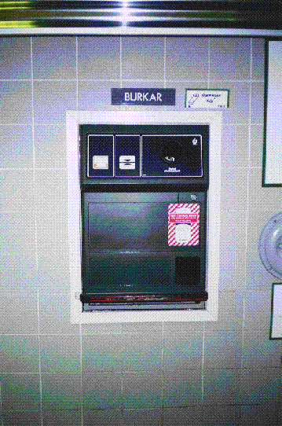
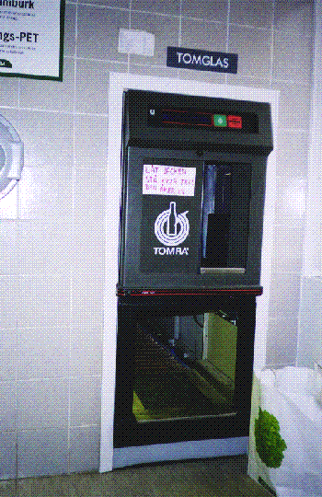
Sample Project: A Recycling Machine
Our customer has seen recycling machines in another country, has taken some photos and wants us to build them for use in our country.
Button
Receipt printer
Button
Receipt printer
Bottle
gate
Can input
Crate gate
Return slot
Notes:
Here is a sample project that we will use throughout the course to illustrate some of the concepts of requirements management. The example is derived from one in Jacobson’s original book on use-case driven development, Object-Oriented Software Engineering.
Here is a sample project that we will use throughout the course to illustrate some of the concepts.
You might explain like this (while looking at this slide or the following slide):
Your customer has seen a recycling machine in Sweden and decided that they want one built here. They give you a couple photos and jot down their “requirements” for the system (next slide).
As you can see this sample is a split configuration - one unit for cans and one unit for bottles and crates.
The can unit returns cans that are not accepted. The machine smashes accepted cans flat, to minimize storage.
Bottles and crates go on the same receipt. The machine will keep all inserted bottles. The regular machine does not contain a bottle sorter. The machine accepts glass bottles and plastic bottles.

Slide 9
Sample Project: Initial Requests
Here are the initial requests:
  There is one unit for cans and another unit for bottles and crates.
  The can unit will return cans that are not accepted in the return slot.
  The machine will flatten accepted cans to minimize storage.
  Bottles and crates will go on the same receipt.
  The machine will keep all inserted bottles.
  The machine does not contain a bottle sorter.
  The machine will accept 1 liter glass bottles, 500 ml. beer bottles, and 2 liter plastic bottles.
Notes:
Here are the initial requests we received from our customer.

Slide 10
What Is the Problem Being Solved?
Fishbone Diagram: One Method for Root-Cause Analysis
in Solving our Sample Problem
Our Customer’s
Stated Problem:
Too Hard to Recycle Now
Environmental Impact
Too Much Litter
We Need
Recycling
Machines Here
Limited Natural Resources
Impact on Unborn Children
People Can Make Money
List contributing causes to the identified problem.
Keep asking “Why?” (expand each rib). How much does each contribute?
Notes:
What problem will this solve? When we ask the customer what problem will be addressed by this system, he answers, “We need recycling machines here.”
Is this really the true problem?
The fishbone diagram is one method for finding the “root cause” of a problem.
The spines are contributing causes to the problem.
Once the root causes have been defined, focus on the ones that contribute most to the problem. You can then further explore the most important root causes to reveal contributing factors to these causes: expand each rib by building spines branching off the rib, or do a separate second-level fishbone diagram with a first-level root cause as “the problem”.
What we often discover is that there may not only be one simple problem involved. Instead there may be many dimensions to and perceptions of what really is the problem. You may need to help the customer focus on the dimensions of the problem that they most need to solve.
Explain the fishbone technique.
If you have time, demonstrate the idea of a second-level fishbone diagram. One easel paper,. Draw another diagram, and put “Too hard to recycle now” as the problem on the right-hand side of the diagram. Ask for contributing causes to this problem. Answers may be “Bins are always full”, “No recycling near where I live”, etc.
Then go on to the next slide to talk about how to focus on the main contributing causes.

Slide 11
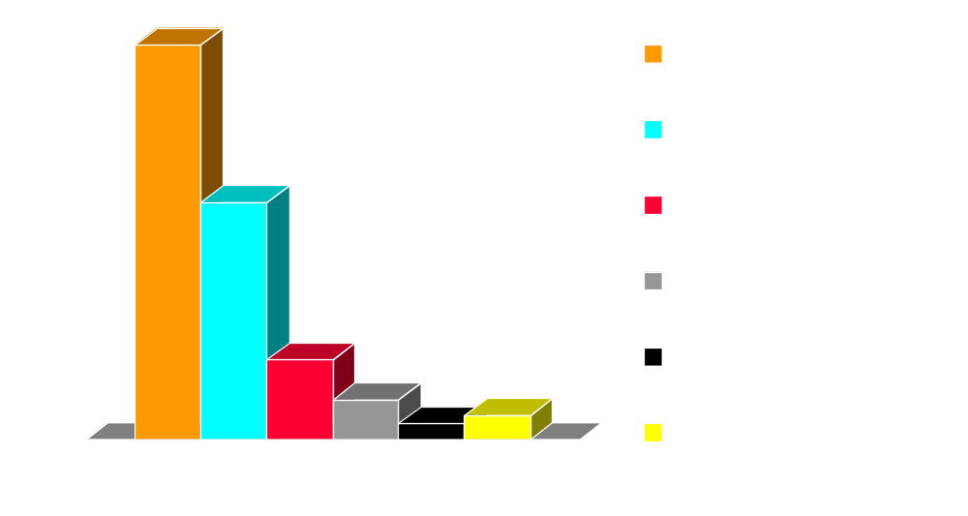
Focus on the Largest Contributors
Pareto Diagram
% Contribution
Rank in order and use the 80-20 Rule to focus on the top contributing causes to address the greatest portion of the problem.
Notes:
One way of focusing on the most important root causes of a problem is the Pareto Principle, or “80-20 rule”.
A Pareto chart ranks the contributing causes in the order of their contribution to the problem, so it is easier to see which are the largest contributors.
Notice that in this example, 80% of the problem is caused by the top 2 contributors.
One way of focusing on the most important root causes of a problem is the Pareto Principle, or “80-20 rule”.
Vilfredo Pareto, a turn-of-the-century Italian economist, studied the distributions of wealth in different countries, concluding that a fairly consistent minority – about 20% – of people controlled the large majority – about 80% – of a society's wealth. This same 80/20 distribution has been observed in many other areas and has been termed the Pareto effect, Pareto Principle, or 80-20 Rule.
The Pareto effect operates in quality improvement: 80% of problems usually stem from 20% of the root causes. Pareto charts are used to display the Pareto principle in action, arranging data so that the few vital factors that are causing most of the problems reveal themselves.
Concentrating improvement efforts on these few will have a greater impact and be more cost-effective than undirected efforts.

Slide 12
Exercise: What Problem Are We Solving?
What is the “problem behind the problem” for our class project?
What the customer
believes to be
the problem
Which of these causes contribute most to the identified problem?
Pick the largest contributor and repeat (putting this item at the head of the fishbone) until the most significant root causes are identified.
Notes:
The purpose of this exercise is to give you a tool to help you discover any hidden problems that may exist in the problem domain of your product. The “real” problem(s) may not be those most obvious at the beginning.
What problem(s) would your project be addressing?
Determine a project that your class can work for the rest of the course. (Maybe have them think about this over lunch, so that they will have some ideas when you get to this slide.)
If they have a problem coming up with a perceived problem, you many want to start with: “We need this new <fill in the blank with the class project>.” Then start asking, “Why?”
Write each of the answers on the ease. You can simply list the suggestions for the class project in table form. Once you have selected a class project, use the fishbone diagram to explore the root causes of the problem.
Keep asking why until the question becomes trivial.
Choose the key contributor(s) and expand them further using the same technique.
Gain agreement within the class on what they believe the problem is that we might solve with a new product.
RECOMMENDED:
Whole-class exercise.
Estimated Time:
5-10 minutes to determine the initial class project.
5-10 minutes for root cause analysis of the problem for the class project.

Slide 13
Exercise: Step 2. Identify the Stakeholders
A stakeholder is anyone who is materially affected by the outcome of the system.
Which of these will be actors in our system?
Notes:
The purpose of this exercise is to understand the “real” stakeholders in your project, in addition to the customer who is paying the bill.
Make sure you consider all those affected by the outcome of the system, including stock shareholders, system maintainers, and developers.
Who are possible stakeholders for your class project?
Based on our definition of actor, which of these will be actors?
Identify potential stakeholders for class problem (write on easel).
Make sure you include things like “shareholders”, maintainers, and developers.
Who are the “key” stakeholders?
Who are the ones that will actually be using the system (potential actors)?
RECOMMENDED:
Whole-class exercise.
Estimated Time: 3-5 minutes

Slide 14

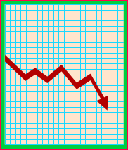
Step 3. Define the System Boundaries
Which of these will be actors in our system?
Users
Other Systems
Legacy
System
New System
Maintenance
Communications
Reports
Notes:
What are the interfaces to outside people or systems for our project?
Based on our definition of actor, which of these will be actors?
What are the interfaces to outside systems for our project?
How can use cases help us figure out these boundaries?
What’s part of the system?
What’s NOT part of the system?
So, which of these will be actors?

Slide 15
Use Actors to Help Define Boundaries
An Actor
Is not part of the system
Is a role a user of the system can play
Can represent a human, a machine, or another system
Can actively interchange information with the system
Can be a giver of information
Can be a passive recipient of information
Actor
Notes:
An actor defines a coherent set of roles that users of the system can play while interacting with it. A user can either be an individual or an external system.
To fully understand the system's purpose you must know who the system is for, that is, who will use it. Different user types are represented as actors.
An actor is anything that exchanges data with the system. An actor can be a user, external hardware, or another system.
The difference between an actor and an individual system user is that an actor represents a particular class of user rather than an actual user. Several users can play the same role, which means they can be one and the same actor. In that case, each user constitutes an instance of the actor.
Actor is a role, not a particular person or thing. The name of the actor should represent, as clearly as possible, the actor’s role.
Make sure that there is little risk of confusing one actor’s name with another at a future stage of the work.

Slide 16
Who Is the Actor? To Help Simplify
Who is pressing the keys (interacting with the system)?
Passenger
Travel Agent
Airline Booking system
The passenger never touches this system; the travel agent operates it. Or perhaps you are building an Internet application ...
Internet Booking system
(airline www page)
Passenger
Notes:
For a person interacting with the system, the simplest question to ask is: “Who is doing the actual interaction?”
This question helps determine a name for the role. The actor is the one interacting who is actually with the system.
What if a person is using a speech recognition system? Then the actor is the one talking with the system.
Explain each system to be built. In the system on top, a travel agent will be interacting with the Airline Booking System.
Ask: Who is the actor? (The answer should be “The travel agent”)
Ask: Is the passenger an actor? (The answer should be “No” because the passenger is not interacting with the system.
In the system on the bottom, a passenger will be interacting with the Internet Booking System.
Ask: Who is the actor? (The answer should be “The passenger”)
Ask: What functionality will be different between the Airline Booking System and the Internet Booking System? (There are many answers, including the user interface and the paying of commissions to travel agents.)
Emphasize that actors will be used to define the boundaries to each system. Knowing who is actually “touching” (or otherwise entering data into) the system gives you a lot of information about what the system must do (what is inside the boundary).
Remember that we are still talking about the steps in Problem Analysis. Knowing the boundary of the problem you need to solve (for example, that you need to pay a commission) will translate later into the boundary of the system to be built.

Slide 17
Instances of Actors
Start
Receipt
Cans
Bottles
Sam
Acts as an Operator
Crates
Jody
Acts as an Operator
Use-Case model
Operator
Print Daily Report
Notes:
The difference between an actor and a system user is that the actor represents a particular type of user rather than an actual user. Several users can play the same role, which means they can be one and the same actor. In that case, each user constitutes an instance of the actor.
In this example, Sam and Jody are operators of a recycling machine. When they are using the machine, each person is an instance of the Operator actor.
However, in some situations, only one person plays the role modeled by an actor. For example, there may be only one system administrator for a rather small system, but the system administrator has, nevertheless, a role of its own.

Slide 18
A User Can Act as Several Actors
Charlie as
Warehouse Manager
D
e
p
o
t
M
a
n
a
g
e
r
Charlie
Charlie as
Warehouse Staff
D
e
p
o
t
S
t
a
f
f
Notes:
The same user can also act as several actors. That is, the same person can take on different roles. In this example, Charlie uses the Depot-Handling System primarily as Depot Manager, but sometimes also as ordinary Depot Staff.
Another example: To an ATM system, Charlie could act as a Customer, but also as an Operator (maintenance user) of the ATM.
It is important to get away from thinking of actors as persons; it’s easier to make changes to a role (or task) than to a person’s job.

Slide 19
Actors Help Determine System Boundaries
System
boundary?
PC
PC
Server
Server
PC
PC
Is the client software part of the system or is the client an actor?
PC
User
Notes:
If we are developing the client software for the PCs, then the “User” would be the actor. If we are developing only the server software, then the “PC” is the actor.

Slide 20
Actors Help Define System Boundaries
System boundary?
Is the Answering Machine an actor or part of the system?
Answering
Machine
(voice mail)
Callee
Caller
Simple Phone
System
Notes:
An answering machine external to the system would be an actor. If we include voice mail in our system, then the voice mail is not an actor.

Slide 21
Useful Questions in Identifying Actors
Who will supply, use, or remove information?
Who will use this functionality?
Who is interested in a certain requirement?
Where in the organization is the system used?
Who will support and maintain the system?
What are the system’s external resources?
What other systems will need to interact with this one?
Actor
Notes:
Here are some useful questions that may be used to help us identify the actors in our system.
Point out that this is an important page. Suggest that the students put a sticky note on it so they can find it easily when they want to identify actors.
Remind students that an actor is a role. For a human actor, you should be able to name several different human beings that can act as a specific actor.

Slide 22
Exercise: Identify Actors
Our
System
Notes:
The purpose of this exercise is to take a first attempt at identifying the actors that will be interacting with our system. Use the questions on the previous page to help you determine if you have found them all.
Use this exercise to come up with the actors that will be interfacing with our class project system.
Use the questions on the preceding slides to help you determine if you’ve found them all.
RECOMMENDED:
Whole-class exercise.
Estimated Time: about 5 minutes

Slide 23

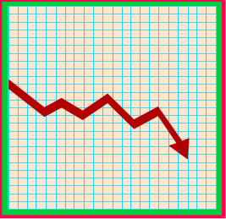

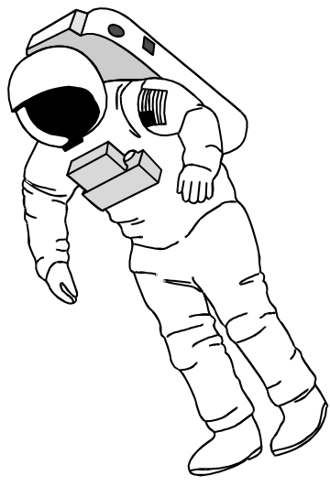
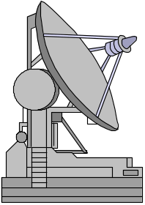
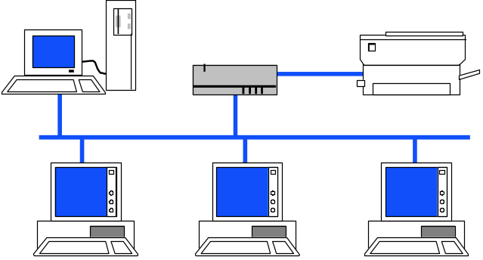
Step 4. Identify Constraints
Political
Economic
Environmental
Technical
Feasibility
System
Notes:
What types of constraints have you experienced in your projects?
Ask the class, “What types of constraints have you experienced in your projects?”
Let them use this slide as a prompt for ideas.

Slide 24
Exercise: Formulating a Problem Statement
Now, using the results of the four Problem Analysis steps just completed, let’s formulate a Problem Statement for our class project.
The problem of
(describe the problem)
affects
(the stakeholders affected by the problem)
The impact of
(what is the impact of the problem)
which is
A successful
(list some key benefits of a successful solution)
solution would
Notes:
It is often useful to have the group agree on a clear statement of the agreed-upon problem that our product will address.
Example: (for a customer support system)
The problem of untimely and improper resolution of customer service issues
affects our customers, customer support representatives, and service technicians.
The impact of which is customer dissatisfaction, perceived lack of quality, unhappy employees and loss of revenue.
A successful solution would provide real-time access to a trouble-shooting database by support representatives, and facilitate dispatch of service technicians, in a timely manner, only to those locations that genuinely need their assistance.
Determine the class problem to be worked on.
You need to do this exercise so that the class project can go forward. The class needs to agree on the statement of the problem that they will solve.
Write the problem statement on easel paper:
Fill out the chart
Narrow down the solution domain
Distinguish solutions/answers from problems/questions
RECOMMENDED:
Whole-class exercise.
Estimated time: 5-10 minutes.

Slide 25
Problem Analysis: Handout
Handout
WP: Problem Analysis
Notes:
A summary of these problem analysis steps is provided in the White Paper by Dean Leffingwell on “Problem Analysis in Applications”, which is located in the Student Handouts.
Explain that it is a summary of this section of the course.

Slide 26

Developing a Glossary
The Glossary
  Defines terms used in the project
  Promotes common understanding of the terminology in the project
  Helps prevent misunderstandings
Start the glossary as soon as possible
Continue developing throughout the project
Glossary
Handout
Example in RMUC Appendix
and TP: Glossary Template
Notes:
Look at the glossary at the back of this manual for a sample.
There should be one Glossary for the system. This document is important to all stakeholders, especially when they need to understand and use terms that are specific to the project. There is a Glossary Template in the TP section of the Student Handouts.
All textual descriptions of the system, especially use-case descriptions should use and refer to the terms defined in the glossary.
In some cases, you may build a domain model to further visualize the terms in the glossary.
Have students look at the Glossary in the Appendix.
How might this help you throughout this course?
And afterwards?
What do the italicized words indicate? (other terms defined in the glossary).
Also, mention the Glossary Template. Don’t bother looking at it now because it it very simple, but tell students it is there for reference in the TP section of the Student Handouts.

Slide 27
Capturing the Vocabulary: A Domain Model?
Class diagram for the requirements domain
Benefits:
  Formalizes the vocabulary for the project
  Simplifies reasoning about different terms
  Describes relationships between terms
  Provides visual representation of terms
Recycle Item
Can
Bottle
Notes:
You may want to represent some of the glossary items in a domain model.
You may want to represent some of the glossary items in a domain model. The idea of a domain model is to represent the objects in the requirements domain in a visual model, using a class diagram or similar technique. This is particularly important if there are relationships that will be clearer if they are shown visually.
We mention the possibility of a domain model here because it is appropriate to construct one during the requirements workflow for some projects. Often, however, it is confusing to try to construct a domain model during the requirements workflow. For most projects, we recommend that the class diagrams of domain objects be deferred until analysis and design. We will not cover the concept of a domain model further in the class.

Slide 28
Defining the Problem
Don’t mistake a solution method for a problem definition
Especially if it’s your own solution method!
Gause & Weinberg, 1982
Notes:
Example: Your office is experiencing productivity problems, so you bring in analysts to help you identify the root causes of your productivity problem.
Ask: What problem do you think an analyst from Sun Microsystems will discover? (Probable answer: Your workstations are too slow. You need faster workstations.)
What problem do you think an analyst from Herman-Miller (a manufacturer of office furniture) will discover? (Probable answer: Your offices are not ergonomically designed. You need better furniture.)
What problem do you think an analyst from Rational Software will discover? (Probable answer: Your tools and processes are weak. You need better tools and processes.)

Slide 29
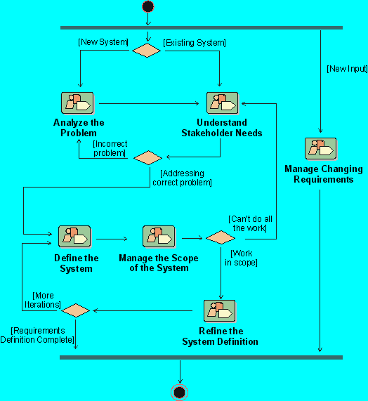
RUP Workflow Detail: Analyze The Problem
Notes:
Where Does the Analyze the Problem detail workflow fit in our development process? This diagram shows the Requirements Workflow in the Rational Unified Process. In this module, we have studied the workflow detail called “Analyze the Problem.” It is a part of the Requirements Workflow that is performed when the problem to be solved is not already well understood.
Where is the “Analyze the Problem” activity done in your own software development process?
This is the first time we look at the Workflow details within the Requirements Management Workflow in RUP. Point out that the workflow details are exactly the activities we are studying in this course. Show which detail we just completed, and how it fits in the entire workflow.
If you are presenting this course on-site at a company not using RUP, discuss the activities they use to accomplish this objective.

Slide 30
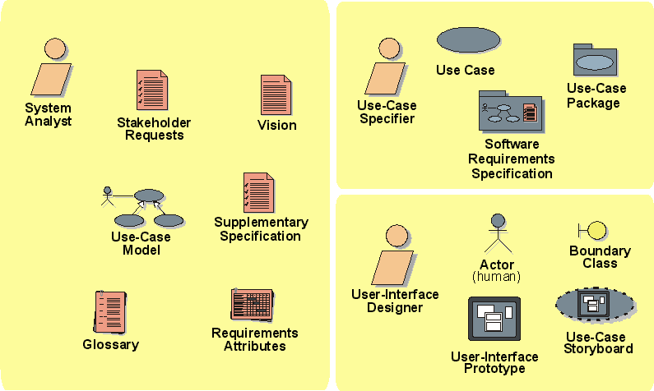
RUP Workers and Artifacts in Requirements Workflow
Notes:
In the Rational Unified Process (RUP), the system analyst leads and coordinates requirements elicitation and use-case modeling by outlining the system's functionality and delimiting the system. For example, the system analyst establishes what actors and use cases exist and how they interact.
The use-case specifier details the specification of a part of the system's functionality by describing the Requirements aspect of one or several use cases. The use-case specifier can also be responsible for a use-case package and maintaining the integrity of that package.
The user-interface designer leads and coordinates the prototyping and design of the user interface, by:
Capturing requirements on the user interface, including usability requirements
Building user-interface prototypes
Involving other stakeholders of the user interface, such as end-users, in usability reviews and use testing sessions
Another important worker in the Requirements workflow is the requirements reviewer, who plans and conducts the formal review of the use-case model and other requirements.
These are the workers involved in the the entire RUP Requirements Workflow.
You can give a brief description of the role of each of these workers in the project. Make sure to emphasize that these are (probably) not job titles -- rather roles that individuals will play throughout the development of the product.
Don’t go into too much detail on the artifacts -- they will be covered later in the course.
If conducting this course on-site with a company using a process other than RUP, then discuss the workers and artifacts used in their process.

Slide 31
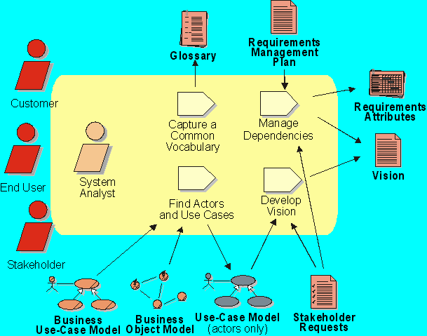
RUP Workflow Detail: Analyze The Problem
Notes:
In RUP, the purpose of this workflow detail is to:
Begin to produce a Vision Document for the project
Agree on key features and goals of the system
This workflow detail may be revisited several times during Inception and early Elaboration. As requests from stakeholders are more clearly understood, both business process solutions and technical solutions will evolve.
The primary activity in analyzing the problem is to start developing the Vision Document, which identifies the high-level user or customer view of the system to be built. In the Vision, initial requirements are expressed as key features the system must possess in order to solve the most critical problems. The features will be assigned attributes such as rationale, priority, and source of request, so that dependencies can begin to be managed. As the Vision develops, the system analyst identifies users and systems -- the actors of the system.
When discussing this slide, point out that the artifacts listed will all benefit from the work we do in analyzing the problem. Much of this will be used in the Vision Document -- which we will continue to develop in the next module.
You can point out that the Requirements Attributes will start to be collected at this time. This will be discussed in detail in the Managing Scope module.

Slide 32
Review: Analyzing the Problem
1. What are the four steps in problem analysis?
2. How can you apply the “Pareto Principle” after determining the root causes of your problem?
3. Who are the stakeholders in your project?
4. What determines the boundaries of a system?
5. What boundaries must be considered when building your product?
6. How can actors be used to help determine the boundaries of a system?
7. What are some of the constraints that will be imposed on your system?
8. Why is it important to establish a glossary?
Notes:
1.
2.
3.
4.
5.
6.
7.
8.
Use these questions to monitor the students’ level of understanding and to help them review.
Tell them they can look back through the material to get the answers.
Give them time to answer. Don’t be afraid to stand quietly while they look up the answer.

